Slide 1

Error Detection and Recovery in Compiler Design
Compilers are essential for translating high-level programming languages into machine-readable code. Error detection and recovery are crucial parts of the compiler design process, ensuring that the compilation process runs smoothly and produces accurate output.
Faculty : Dr. G. Machel

Slide 2
Importance of Error Handling in Compilers
Program Reliability
User Experience
Error handling ensures that the compiler can identify and report errors, preventing the creation of faulty programs.
Error detection helps users understand why their code is not compiling and provides guidance on how to fix the issue.

Slide 3

Common Errors in Compiler Design
Lexical Errors
Syntax Errors
These errors occur during the lexical analysis phase, where the compiler reads the source code character by character.
These errors occur during the syntax analysis phase, where the compiler checks if the code follows the grammar rules of the language.
Semantic Errors
These errors occur during the semantic analysis phase, where the compiler checks for logical errors and type mismatches in the code.

Slide 4
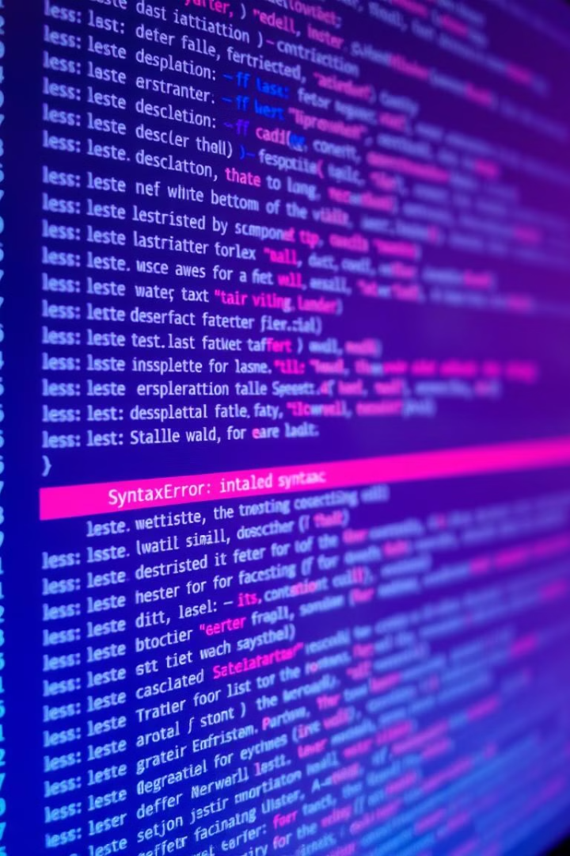
Lexical Analysis Errors
1
Invalid Characters
2
Unrecognized Keywords
The compiler encounters an illegal character that is not part of the programming language's vocabulary.
The compiler cannot identify a keyword or identifier that is not defined in the language.
3
Missing Delimiters
The compiler encounters a missing opening or closing delimiter, such as a parenthesis, bracket, or quote.

Slide 5


Syntax Analysis Errors
Missing Semicolons
Unbalanced Parentheses
Incorrect Keyword Usage
A semicolon is missing in a statement where it is required.
The number of opening and closing parentheses in an expression does not match.
A keyword is used in an invalid context, such as using "if" instead of "while".

Slide 6
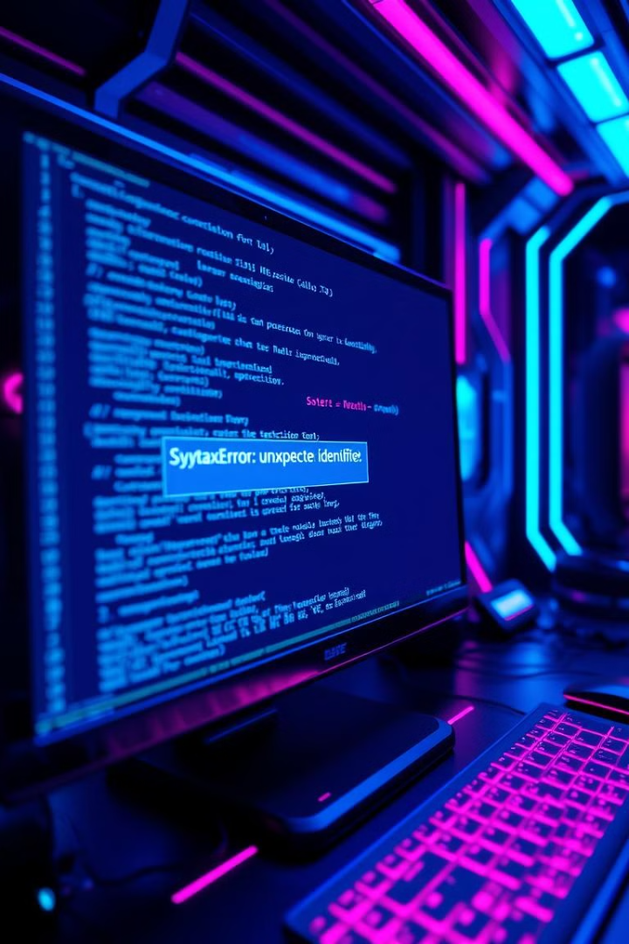
Semantic Analysis Errors
1
Type Mismatches
An operation attempts to combine incompatible data types, such as adding a string to an integer.
2
Undeclared Variables
The compiler encounters a variable that has not been declared or defined before it is used.
3
Variable Scope Issues
A variable is accessed from a scope where it is not defined or visible.

Slide 7
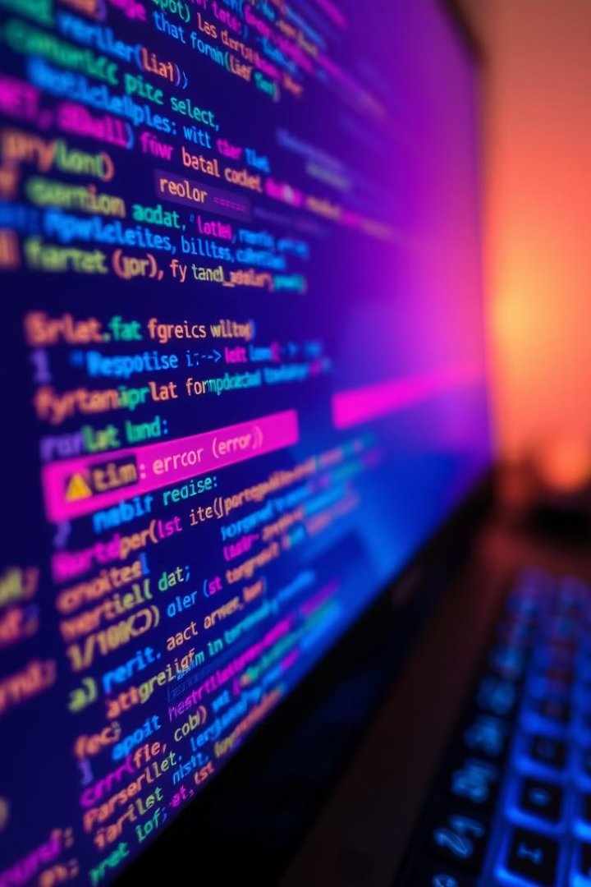



Techniques for Error Detection
Lexical Analysis
The compiler uses a finite state machine to analyze the input stream and identify lexical errors.
Syntax Analysis
The compiler uses a parsing algorithm, such as LL or LR parsing, to check if the code conforms to the language's grammar.
Semantic Analysis
The compiler uses a symbol table to track variables and their types and to perform type checking.

Slide 8



Strategies for Error Recovery
Panic Mode
1
The compiler discards input until it finds a valid token.
Phrase Level Recovery
2
The compiler attempts to insert or delete tokens to create a valid phrase.
Error Correction
3
The compiler attempts to identify and fix the error based on a set of rules.

Slide 9

Conclusion
Error detection and recovery play a vital role in ensuring the accuracy and reliability of compilers. Understanding the various types of errors, detection techniques, and recovery strategies empowers developers to create robust and user-friendly applications.

